Slide 1
Subnetting/Supernetting
and
Classless Addressing

Slide 2
Address Depletion
What is Address Deletion Problem in Classful Addressing?
Solutions:
  Short term Solution
    Use of Private Addresses
    Subnetting
    Supernetting
    Use of NAT and DHCP
    Classless Addressing
  Long term Solution
    IPv6

Slide 3
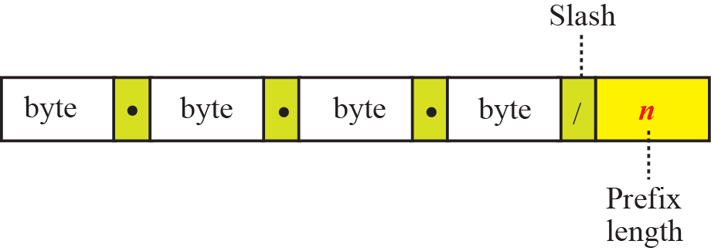
Prefix Length: Slash Notation
In classless addressing, Prefix length need to be passed separately.
Prefix length is added to the address.
Notation is informally referred as slash notation and formally CIDR (Classless Inter-domain Routing)
In classless addressing, we need to know one of the addresses in the block and the prefix length to define the block.

Slide 4
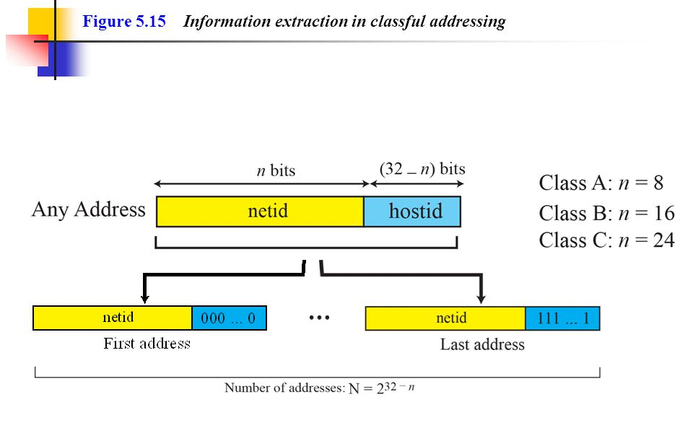

Slide 5
SUBNETTING

Slide 6
IP addresses are designed with
two levels of hierarchy.

Slide 7
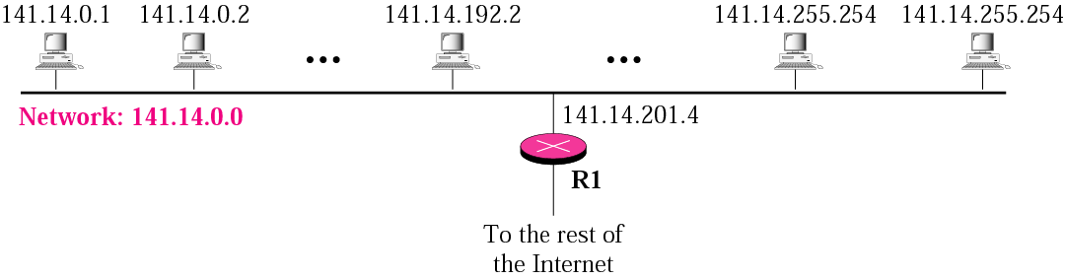
A network with two levels of
hierarchy (not subnetted)

Slide 8
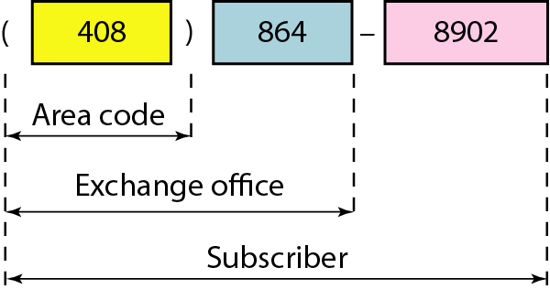
Example of Multi-Level Hierarchy

Slide 9
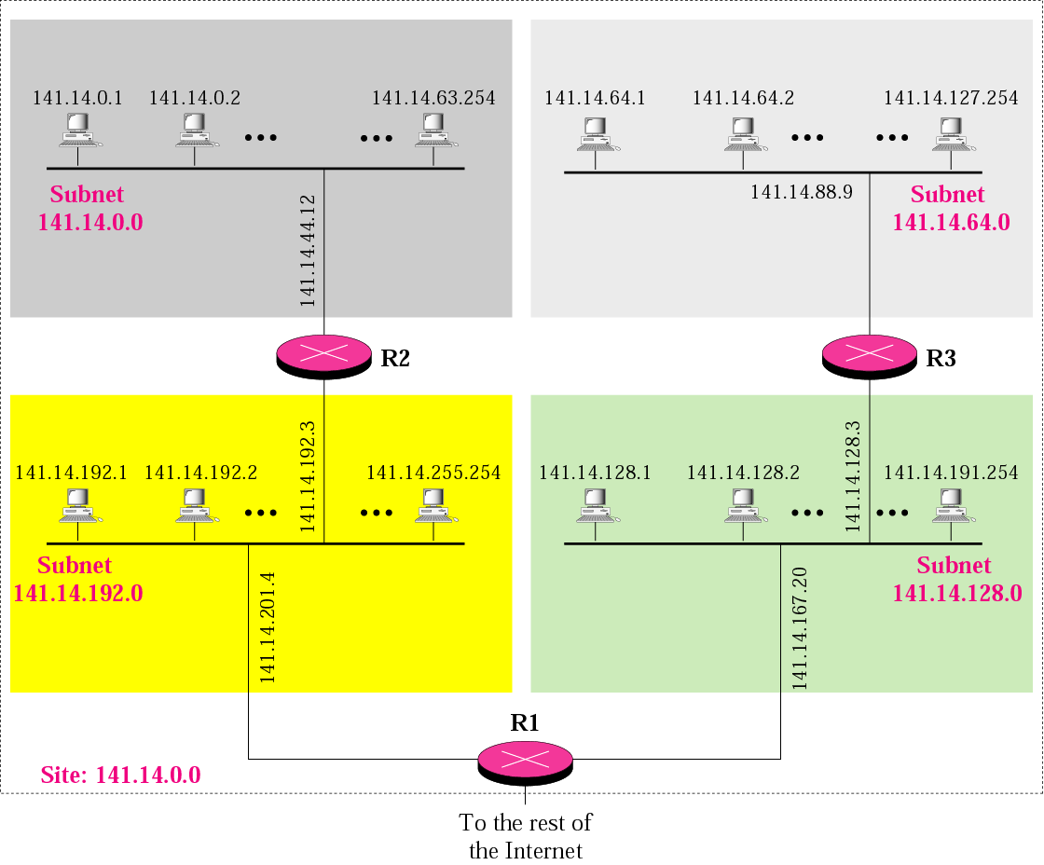
A network with three levels of
hierarchy (subnetted)

Slide 10
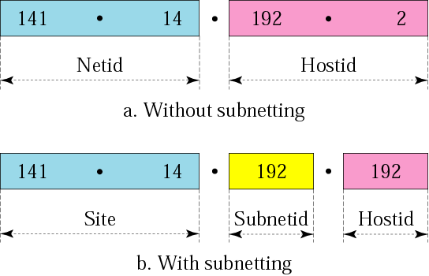
Addresses in a network with
and without subnetting

Slide 11
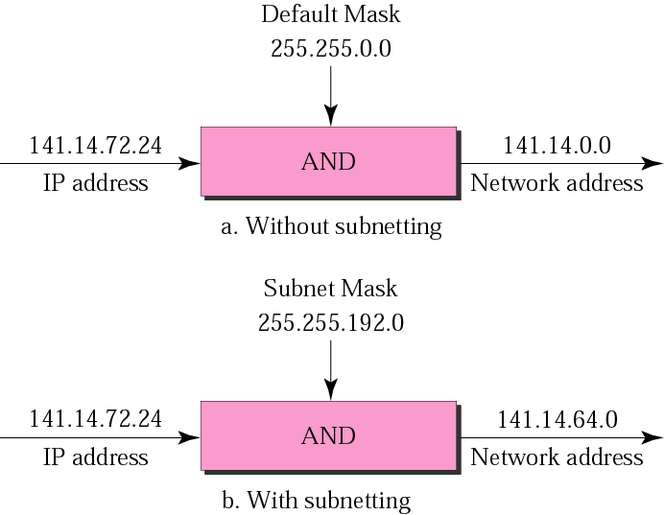
Default mask and subnet mask

Slide 12
Finding the Subnet Address
Given an IP address, we can find the subnet address the same way we found the network address in the previous chapter. We apply the mask to the address.

Slide 13
Straight Method
In the straight method, we use binary notation for both the address and the mask and then apply the AND operation to find the subnet address.

Slide 14
Example 1
What is the subnetwork address if the destination address is 200.45.34.56 and the subnet mask is 255.255.240.0?

Slide 15
Solution
11001000 00101101 00100010 00111000
11111111 11111111 11110000 00000000
11001000 00101101 00100000 00000000
The subnetwork address is 200.45.32.0.

Slide 16
Short-Cut Method
    ** If the byte in the mask is 255, copy the byte in the address.
    ** If the byte in the mask is 0, replace the byte in the address with 0.
    ** If the byte in the mask is neither 255 nor 0, we write the mask and the address in binary and apply the AND operation.

Slide 17
Example 2
What is the subnetwork address if the destination address is 19.30.80.5 and the mask is 255.255.192.0?
Solution

Slide 18
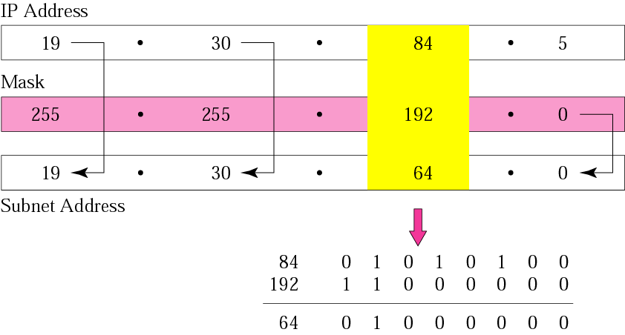
Figure 5-6
Example 2

Slide 19
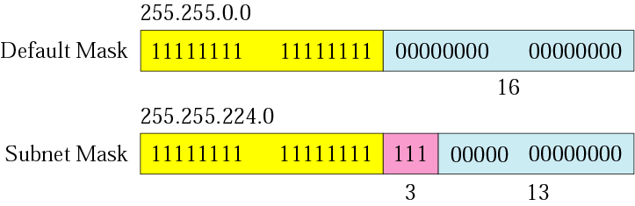
Figure 5-7
Comparison of a default mask and
a subnet mask

Slide 20
The number of subnets must be
a power of 2.

Slide 21
Example 3
A company is granted the site address 201.70.64.0 .The company needs six subnets. Design the subnets.
Solution
The number of 1s in the default
mask is 24 (class C).

Slide 22
Solution (Continued)
The company needs six subnets. This number 6 is not a power of 2. The next number that is a power of 2 is 8 (2³). We need 3 more 1s in the subnet mask. The total number of 1s in the subnet mask is 27 (24 + 3).
The total number of 0s is 5 (32 − 27). The mask is

Slide 23
Solution (Continued)
11111111 11111111 11111111 11100000
or
255.255.255.224
    The number of subnets is 8.
    The number of addresses in each subnet is 2⁵ (5 is the number of 0s) or 32.

Slide 24
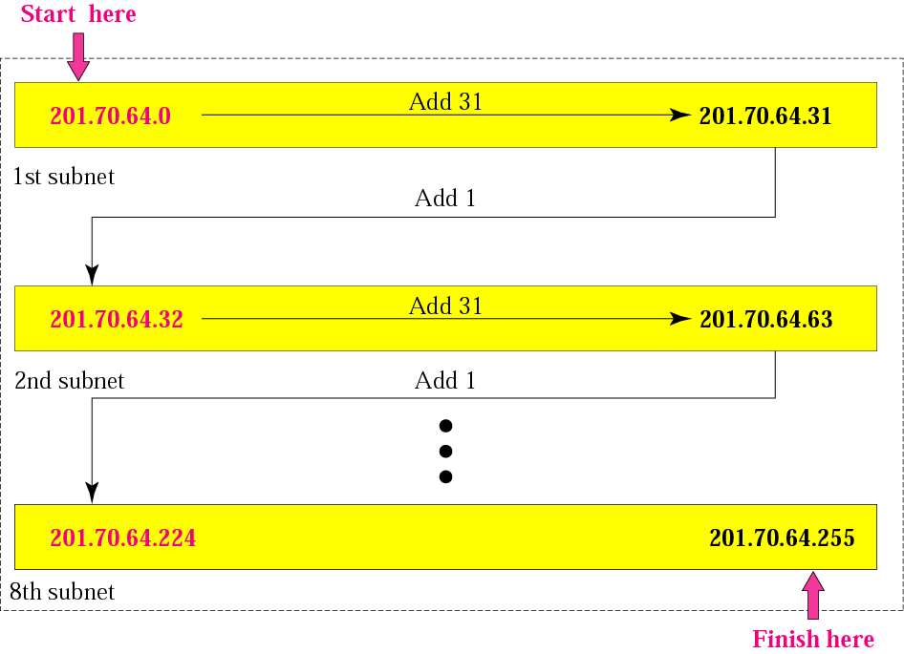
Example 3

Slide 25
Example 4
A company is granted the site address 181.56.0.0. The company needs 1000 subnets. Design the subnets.
Solution
The number of 1s in the default mask is 16 (class B).

Slide 26
Solution (Continued)
The company needs 1000 subnets. This number is not a power of 2. The next number that is a power of 2 is 1024 (2¹⁰). We need 10 more 1s in the subnet mask.
The total number of 1s in the subnet mask is 26 (16 + 10).
The total number of 0s is 6 (32 − 26).

Slide 27
Solution (Continued)
The mask is
11111111 11111111 11111111 11000000
or
255.255.255.192.
The number of subnets is 1024.
The number of addresses in each subnet is 2⁶ (6 is the number of 0s) or 64.
See Figure 5.9

Slide 28
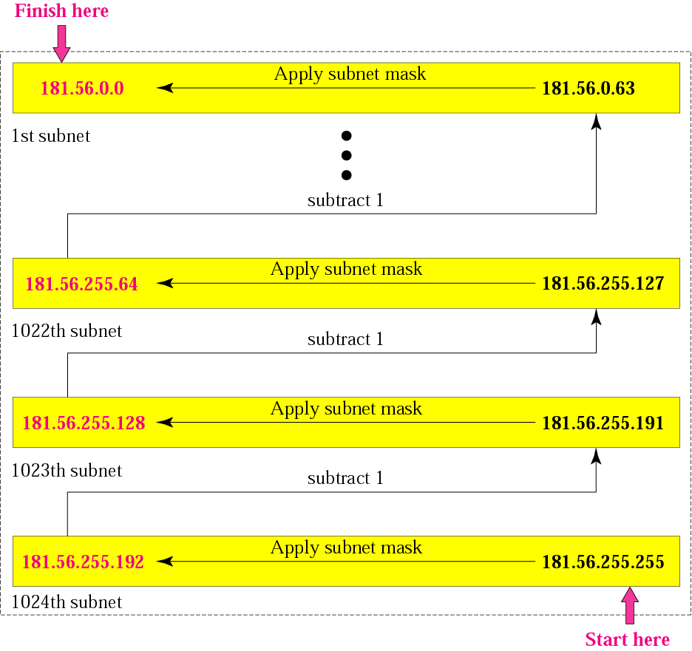
Example 4

Slide 29
Example 5
Network address given to an organization is 200.50.100.0. After subnetting new Mask is /27.
  Find number of subnets and subnet address of each subnet.
  Find number of IP address in each subnet.

Slide 30
Solution 5
Initial mask : 24
New mask is /27
No of bits used for subnetting =
Total Subnets created =
No. of IP Address in each subnet =
27-24 = 3
2³ = 8
2³²⁻²⁷ = 2⁵ = 32

Slide 31
Solution 5
Starting Address of 1st Subnet =200.50.100.0
Starting Address of 2nd Subnet =200.50.100.32
Starting Address of 3rd Subnet =200.50.100.64
Starting Address of 4th Subnet =200.50.100. 96
Starting Address of 5th Subnet =200.50.100.128
Starting Address of 6th Subnet =200.50.100.160
Starting Address of 7th Subnet =200.50.100. 192
Starting Address of 8th Subnet =200.50.100.224

Slide 32
Example 6
IP address given to an organization is 170.50.100.70. After subnetting Number of valid hosts in each subnet are 4094.
  Find mask of subnets created.
  Find number of subnets and subnet address of each subnet.

Slide 33
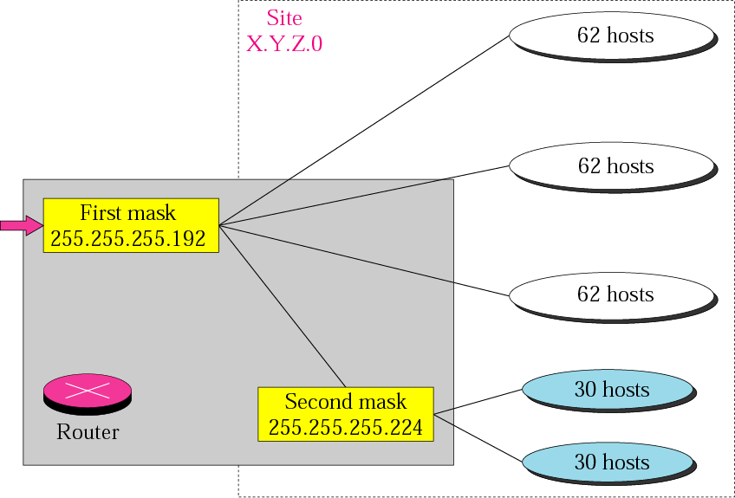
Variable-length subnetting
Default Mask
255.255.255.0

Slide 34
CLASSLESS ADDRESSING

Slide 35
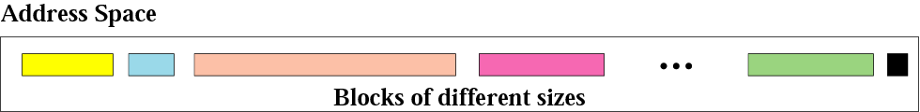
Figure 5-13
Variable-length blocks

Slide 36
Number of Addresses in a Block
There is only one condition on the number of addresses in a block; it must be a power of 2 (2, 4, 8, . . .).

Slide 37
Beginning Address
The beginning address must be evenly divisible by the number of addresses. For example, if a block contains 4 addresses, the beginning address must be divisible by 4.
If the block has less than 256 addresses, we need to check only the rightmost byte. If it has less than 65,536 addresses, we need to check only the two rightmost bytes, and so on.

Slide 38
Example 9
Which of the following can be the beginning address of a block that contains 16 addresses?
205.16.37.32
190.16.42.44
17.17.33.80
123.45.24.52
Solution
The address 205.16.37.32 is eligible because 32 is divisible by 16. The address 17.17.33.80 is eligible because 80 is divisible by 16.

Slide 39
Example 10
Which of the following can be the beginning address of a block that contains 1024 addresses?
205.16.37.32
190.16.42.0
17.17.32.0
123.45.24.52
Solution
To be divisible by 1024, the rightmost byte of an address should be 0 and the second rightmost byte must be divisible by 4. Only the address 17.17.32.0 meets this condition.

Slide 40
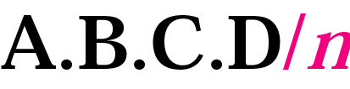
Slash notation or CIDR notation

Slide 41
Slash notation is also called
CIDR
notation.

Slide 42
Example 11
A small organization is given a block with the beginning address and the prefix length 205.16.37.24/29 (in slash notation). What is the range of the block?
Solution
The beginning address is 205.16.37.24. To find the last address we keep the first 29 bits and change the last 3 bits to 1s.
Beginning:11001111 00010000 00100101 00011000
Ending : 11001111 00010000 00100101 00011111
There are only 8 addresses in this block.

Slide 43
Example 12
We can find the range of addresses in Example 11 by another method. We can argue that the length of the suffix is 32 − 29 or 3. So there are 2³ = 8 addresses in this block. If the first address is 205.16.37.24, the last address is 205.16.37.31 (24 + 7 = 31).

Slide 44
A block in classes A, B, and C
can easily be represented in slash
notation as
A.B.C.D/ n
where n is
either 8 (class A), 16 (class B), or
24 (class C).

Slide 45
Example 13
What is the network address if one of the addresses is 167.199.170.82/27?
Solution
The prefix length is 27, which means that we must keep the first 27 bits as is and change the remaining bits (5) to 0s. The 5 bits affect only the last byte. The last byte is 01010010. Changing the last 5 bits to 0s, we get 01000000 or 64. The network address is 167.199.170.64/27.

Slide 46
Example 14
An organization is granted the block 130.34.12.64/26. The organization needs to have four subnets. What are the subnet addresses and the range of addresses for each subnet?
Solution
The suffix length is 6. This means the total number of addresses in the block is 64 (2⁶). If we create four subnets, each subnet will have 16 addresses.

Slide 47
Solution (Continued)
Let us first find the subnet prefix (subnet mask). We need four subnets, which means we need to add two more 1s to the site prefix. The subnet prefix is then /28.
Subnet 1: 130.34.12.64/28 to 130.34.12.79/28.
Subnet 2 : 130.34.12.80/28 to 130.34.12.95/28.
Subnet 3: 130.34.12.96/28 to 130.34.12.111/28.
Subnet 4: 130.34.12.112/28 to 130.34.12.127/28.
See Figure 5.15

Slide 48
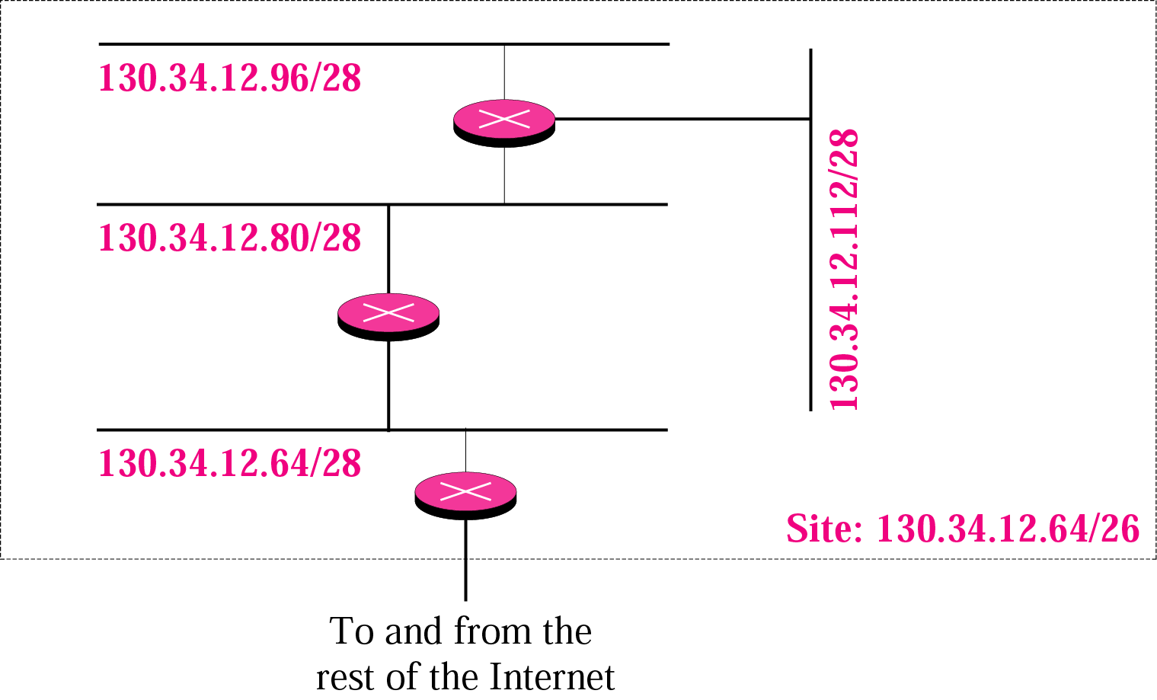
Figure 5-15
Example 14

Slide 49
Example 15
An organization is granted a block of addresses with beginning address 14.24.74.0/24. The organization needs to have 3 blocks of addresses to use in its three subnets as shown below:
  One block of 120 addresses.
  One block of 60 addresses.
  One block of 10 addresses.

Slide 50
Solution
Total Addresses in block = 2³²-2²⁴ = 256
first address = 14.24.74.0/24
Last address = 14.24.74.255/24
No. of addresses in first block is not power of 2. We allocate 128 addresses.
subnet mask =25
No. of addresses in first block is not power of 2. We allocate 64 addresses.
subnet mask =26
No. of addresses in first block is not power of 2. We allocate 16 addresses.
subnet mask =28

Slide 51
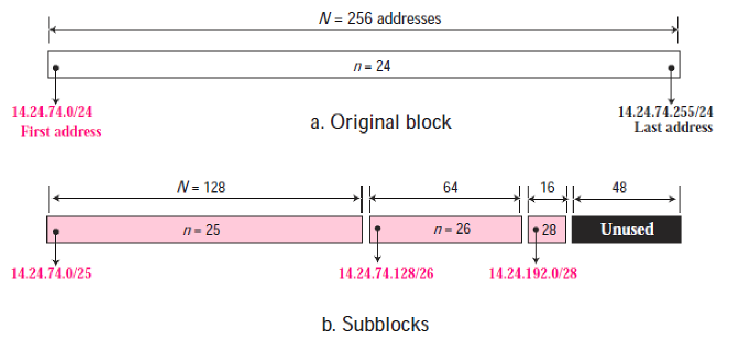

Slide 52
Example 16
Assume a company has three offices: Central, East, and West. The Central office is connected to the East and West offices via private, WAN lines. The company is granted a block of 64 addresses with the beginning address 70.12.100.128/26. The management has decided to allocate 32 addresses for the Central office and divides the rest of addresses between the two other offices.
1. The number of addresses are assigned as follows:
2. We can find the prefix length for each subnetwork:

Slide 53
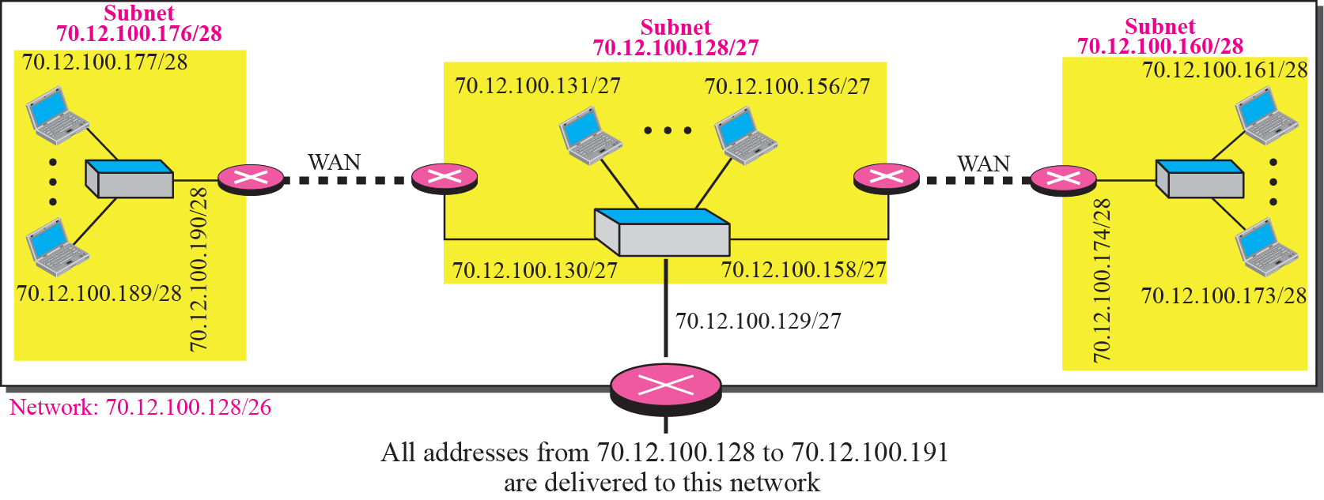

Slide 54
Example 17
An ISP is granted a block of addresses starting with 190.100.0.0/16. The ISP needs to distribute these addresses to three groups of customers as follows:
1. The first group has 64 customers; each needs 256 addresses.
2. The second group has 128 customers; each needs 128 addresses.
3. The third group has 128 customers; each needs 64 addresses.
Design the subblocks and give the slash notation for each subblock. Find out how many addresses are still available after these allocations.

Slide 55
Solution
Group 1
For this group, there are 64 customers and each customer needs 256 addresses.
Total addresses = 64 × 256 = 16,384 = 2¹⁴
new mask = 32-14=/18
First address of Group 1 : 190.100.0.0/18
Last address of Group 1 : 190.100.63.255/18

Slide 56
Solution (Continued)
Group 2
For this group, there are 128 customers and each customer needs 128 addresses.
Total addresses = 128 × 128 = 16,384 = 2¹⁴
new mask = 32-14=/18
First address of Group 1 : 190.100.64.0/18
Last address of Group 1 : 190.100.127.255/18

Slide 57
Solution (Continued)
Group 3
For this group, there are 128 customers and each customer needs 64 addresses.
Total addresses = 128 × 64 = 8192 = 2¹³
new mask = 32-13=/19
First address of Group 1 : 190.100.128.0/19
Last address of Group 1 : 190.100.159.255/19

Slide 58
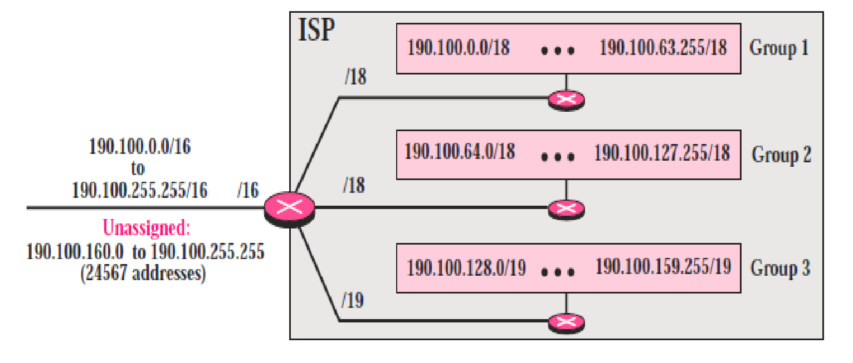
Step 1:

Slide 59
Solution
Group 1
For this group, there are 64 sub blocks .
Old Subnet mask = /18
New subnet mask = 18+log(2⁶ )=18+6=24
01: 190.100.0.0/24 🡺190.100.0.255/24
02: 190.100.1.0/24 🡺190.100.1.255/24
…………………………………..
64: 190.100.63.0/24🡺190.100.63.255/24

Slide 60
Solution (Continued)
Group 2
For this group, there are 128 sub blocks .
Old Subnet mask = /18
New subnet mask = 18+log(2⁷ )=18+7=25
001: 190.100.64.0/25 🡺190.100.64.127/25
002: 190.100.64.128/25 🡺190.100.64.255/25
003: 190.100.127.128/25 🡺190.100.127.255/25

Slide 61
Solution (Continued)
Group 3
For this group, there are 128 sub blocks .
Old Subnet mask = /19
New subnet mask = 19+log(2⁷ )=19+7=26
001:190.100.128.0/26 🡺190.100.128.63/26
002:190.100.128.64/26 🡺190.100.128.127/26
…………………………
128:190.100.159.192/26 🡺190.100.159.255/26

Slide 62
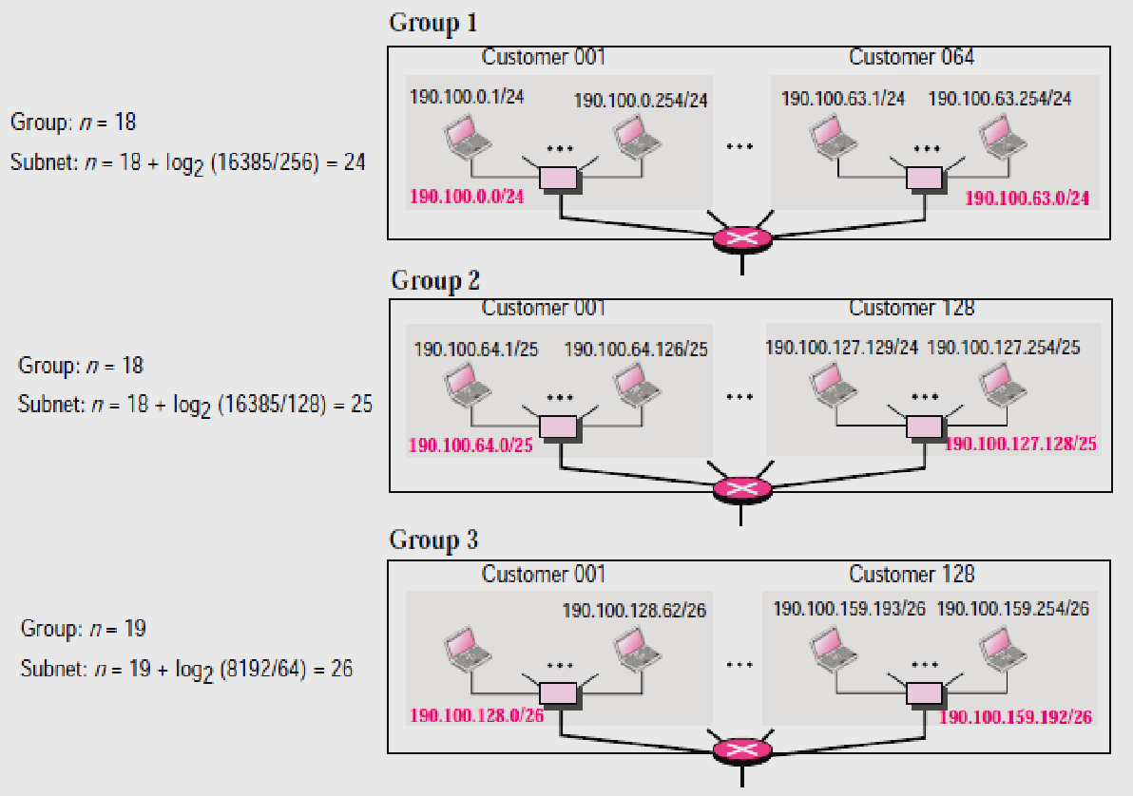
Step 2:

Slide 63
Solution (Continued)
Number of granted addresses: 65,536
Number of allocated addresses: 40,960
Number of available addresses: 24,576

Slide 64
SUPERNETTING
(also referred as Summarization, Aggregation)

Slide 65
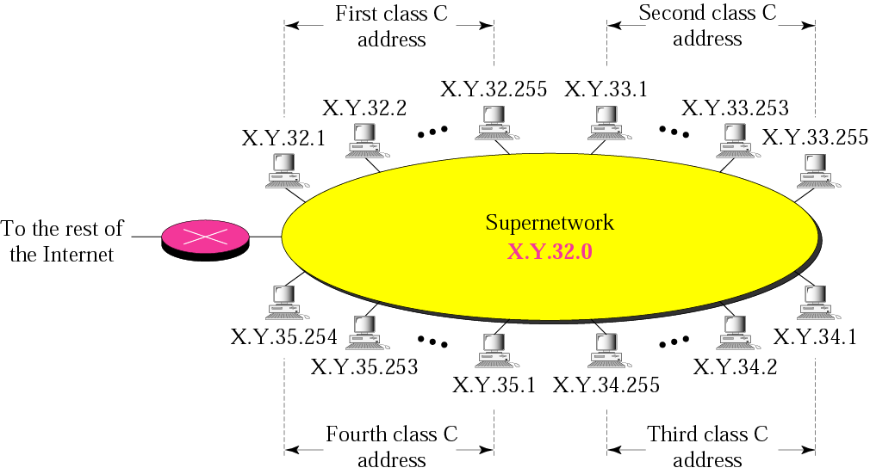
A supernetwork

Slide 66
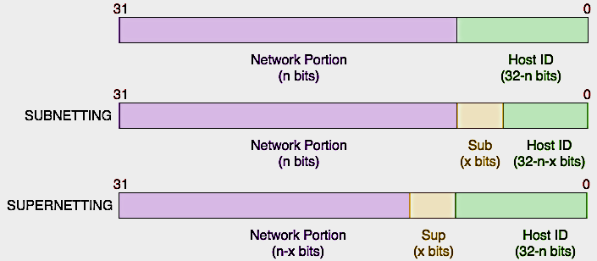
What is Supernetting?
  aggregating networks together to form a larger network
Why Supernetting?
The main purpose of supernetting is reducing the size of the routing table on routers
It saves memory and processing resources on routing devices.
also helped slow down the exhaustion of IP addresses through the use of Classless Inter-Domain Routing (CIDR).

Slide 67
Rules: (For Class C Addresses)
** The number of blocks must be a power of 2 (1, 2, 4, 8, 16, . . .).
** The blocks must be contiguous in the address space (no gaps between the blocks).
** The third byte of the first address in the superblock must be evenly divisible by the number of blocks. In other words, if the number of blocks is N, the third byte must be divisible by N.

Slide 68
Example 5
A company needs 600 addresses. Which of the following set of class C blocks can be used to form a supernet for this company?
198.47.32.0 198.47.33.0 198.47.34.0
198.47.32.0 198.47.42.0 198.47.52.0 198.47.62.0
198.47.31.0 198.47.32.0 198.47.33.0 198.47.34.0
198.47.32.0 198.47.33.0 198.47.34.0 198.47.35.0

Slide 69
Solution
1: No, there are only three blocks.
2: No, the blocks are not contiguous.
3: No, 31 in the first block is not divisible by 4.
4: Yes, all three requirements are fulfilled.

Slide 70
In subnetting,
we need the first address of the
subnet and the subnet mask to
define the range of addresses.

Slide 71
In supernetting,
we need the first address of
the supernet
and the supernet mask to
define the range of addresses.

Slide 72
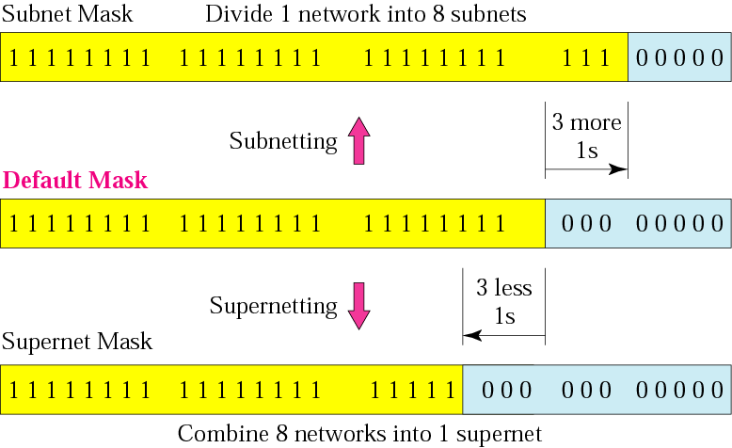
Figure 5-12
Comparison of subnet, default,
and supernet masks

Slide 73
Example 6
We need to make a supernetwork out of 16 class C blocks. What is the supernet mask?
Solution
We need 16 blocks. For 16 blocks we need to change four 1s to 0s in the default mask. So the mask is
11111111 11111111 11110000 00000000
or
255.255.240.0

Slide 74
Example 7
A supernet has a first address of 205.16.32.0 and a supernet mask of 255.255.248.0. A router receives three packets with the following destination addresses:
    205.16.37.44
    205.16.42.56
    205.17.33.76
Which packet belongs to the supernet?

Slide 75
Solution
We apply the supernet mask to see if we can find the beginning address.
205.16.37.44 AND 255.255.248.0 🡺 205.16.32.0
205.16.42.56 AND 255.255.248.0 🡺 205.16.40.0
205.17.33.76 AND 255.255.248.0 🡺 205.17.32.0
Only the first address belongs to this supernet.

Slide 76
Example 8
A supernet has a first address of 205.16.32.0 and a supernet mask of 255.255.248.0. How many blocks are in this supernet and what is the range of addresses?
Solution
The supernet has 21 1s. The default mask has 24 1s. Since the difference is 3, there are 2³ or 8 blocks in this supernet. The blocks are 205.16.32.0 to 205.16.39.0. The first address is 205.16.32.0. The last address is 205.16.39.255.

